Slide 1
Orexin and Alzheimer’s Disease
Morgan Rothschadl
brain stress circuitry – orexin connections
March 6, 2024

Slide 2
Main Characters
Alzheimer’s Disease: neurodegenerative disease
Sleep: necessary restorative process for the body
Orexin: peptide with many functions in the body

Slide 3
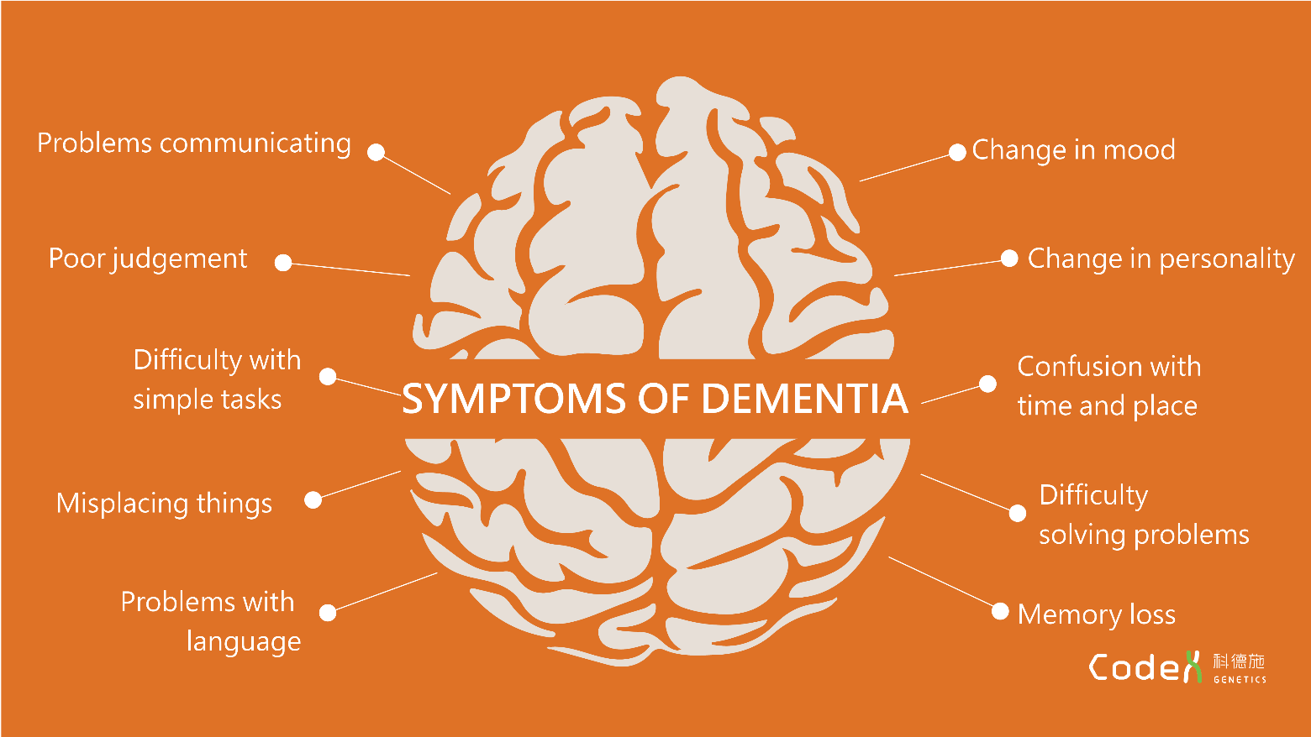
Alzheimer’s Disease (AD)
AD = most prominent form of dementia (50-75%)
6.5 million Americans with AD in 2022
total Medicaid spending for AD and other dementias = ~$60 billion in 2022
Sleep-specific symptoms (25-60% of patients):
- increased nocturnal wakening (insomnia)
- sleep fragmentation
- disruptions in REM and NREM sleep
- excessive daytime sleep

Slide 4
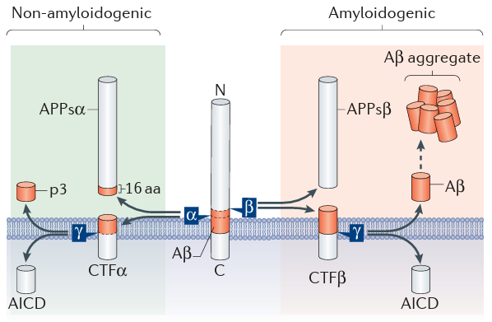
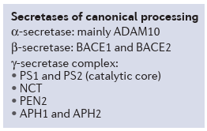
Amyloid-beta (Aβ) Processing
APP
Muller et al., Nature Reviews, Neuroscience (2017); APP = amyloid precursor protein

Slide 5
Hyperphosphorylated Tau Aggregation

Slide 6
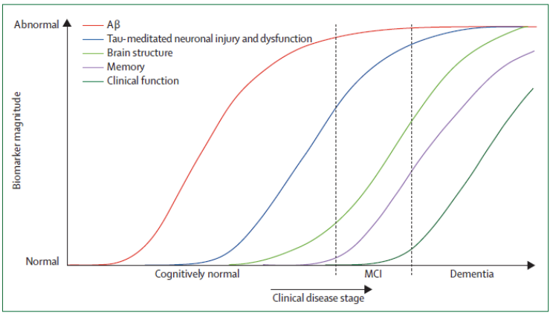
AD Progression
Jack et al., Lancet Neurology (2010)

Slide 7
AD Mouse Models
APP transgenic (Tg2576): APP K670N_M671L
APP/PS1: APP K670N_M671L and PSEN1 L166P
3xTg: APP K670N_M671L, MAPT P301L, PSEN1 M146V
Alzforum.org

Slide 8
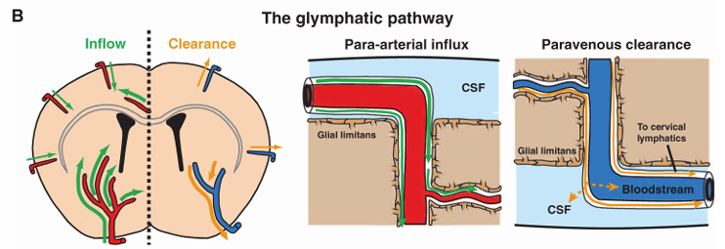
What does sleep do for the brain?
sleep enlarges interstitial space of cerebral cortex
allows ↑convective exchange between cerebrospinal fluid (CSF) and interstitial fluid (ISF)
clears products from neurotoxic and neuroactive degradation
consolidates memories, impacts immune health, etc.
Zhou and Tang, Frontiers in Medicine (2023); Xie et al., Science (2013)
Notes:
Interstitial fluid is found in the space between blood vessels and cells and contains nutrients and waste products.
Convective exchange: CSF flows throughout the brain as we sleep (entering via arteries), picking up toxic waste products as it flows. It then exchanges these waste products in the ISF (exiting out the veins), where they will be taken by the lymphatic system to the liver to be degraded.
Graph is showing Abeta clearance in awake vs sleeping (naturally) and anesthetized mice.

Slide 9
Aβ dynamics with sleep/wake
Kang et al., Science (2009)

Slide 10
Sleep restriction can exacerbate Aβ plaques.
Kang et al., Science (2009)

Slide 11
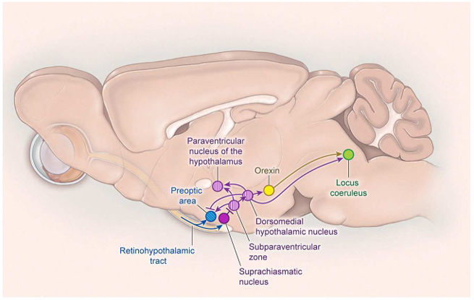
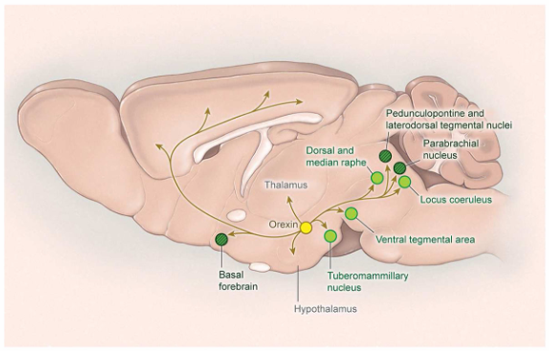
What role does orexin play in sleep?
receives input from wake/sleep promoting areas
sends signals to brain areas to promote wakefulness
Scammell et al., Neuron (2017)

Slide 12
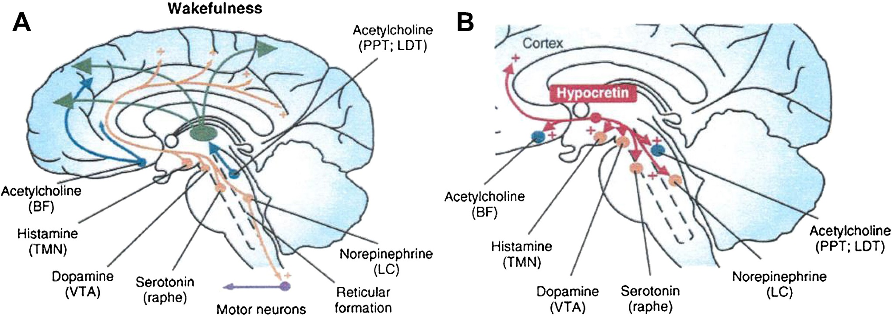
Sleep and AD
Basal forebrain cholinergic neurons
Promote fast cortical activity – attention, memory, sensory processing, cortical plasticity
Loss could lead to overcompensation by other arousal systems (i.e. orexin)
Zhou and Tang, Frontiers in Medicine (2023)

Slide 13
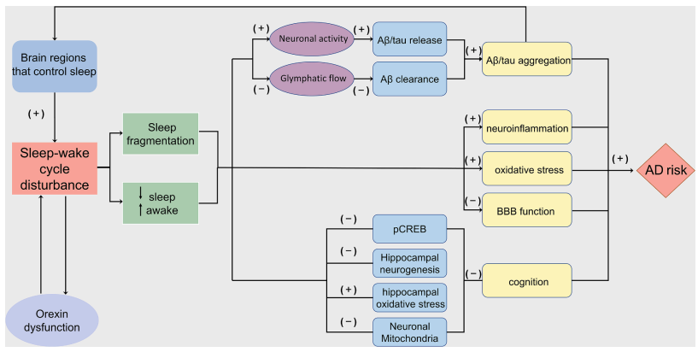
Connections between Orexin, AD, and Sleep
Gao et al., Neuroscience Letters (2021)

Slide 14
Theme
Orexin impacts non-pathological and pathological (AD) states differently.

Slide 15
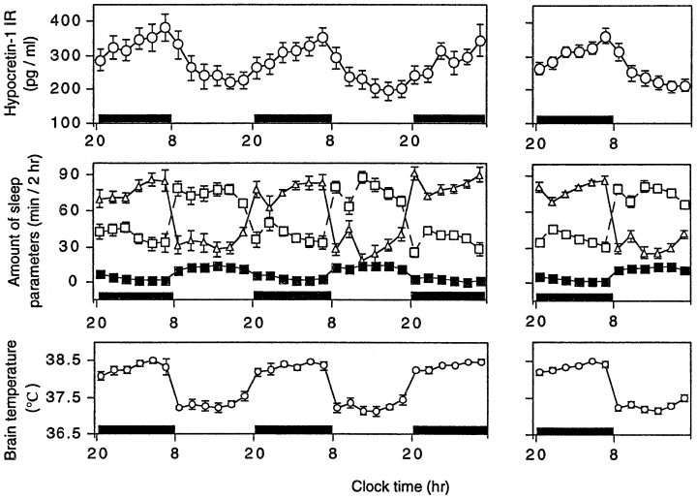
Normal Orexin (OX) Daily Rhythms
Dark bars = active period
Orexin A
wakefulness
slow wave sleep
REM sleep
Yoshida et al., European Journal of Neuroscience (2001)

Slide 16
OX decreases with age (non-pathological)
both number and morphology of orexin neurons changes
Infants: 0-1 year; children: 4-10 years; young adults: 22-32 years; older adults: 48-60 years
Hunt et al., Neurobiology of Aging (2015); Terao et al., Neuroscience Letters (2002)

Slide 17
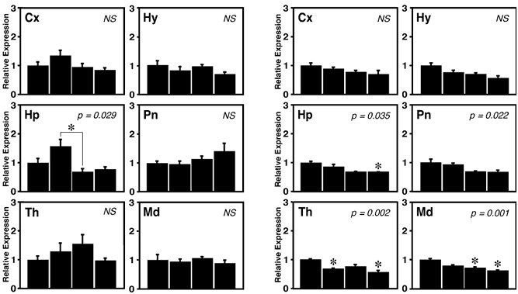
OX decreases with age (non-pathological)
both number and morphology of orexin neurons changes
OX receptors are also seen to change
OX1R OX2R
Infants: 0-1 year; children: 4-10 years; young adults: 22-32 years; older adults: 48-60 years
Hunt et al., Neurobiology of Aging (2015); Terao et al., Neuroscience Letters (2002)

Slide 18
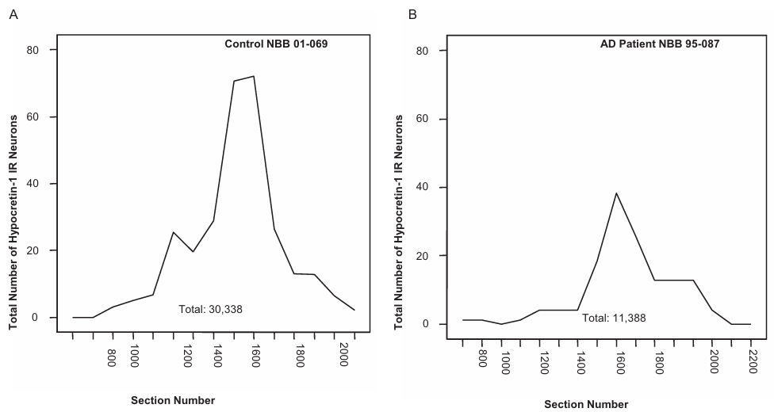
Total number of orexin immunoreactive neurons decreases during AD.
female AD patients = 40% less orexin immunoreactive neurons vs males
female control patients = 25% fewer orexin immunoreactive neurons vs males
Fronczek et al., Neurobiology of Aging (2012); postmortem studies

Slide 19
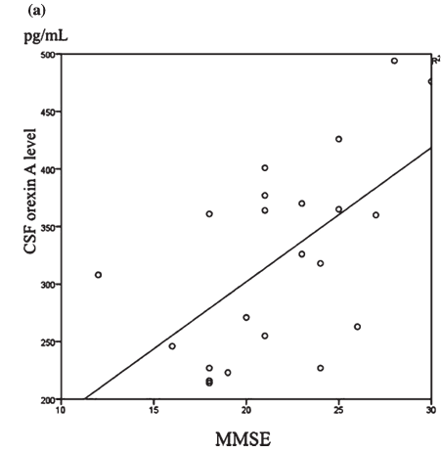
OX loss correlates with worsening cognition.
Higher MMSE = better cognitive functioning
Shimizu et al., Journal of Alzheimer’s Disease (2020)

Slide 20
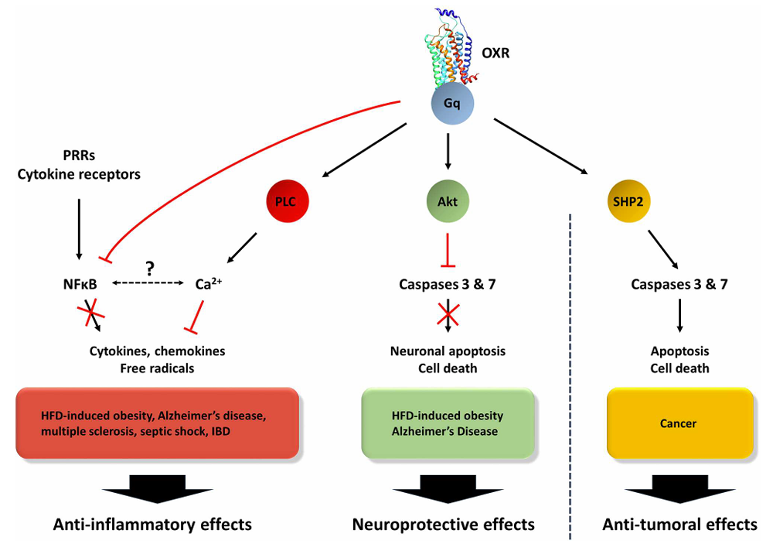
OX can reduce inflammation and apoptosis.
Couvineau et al., Frontiers in Endocrinology (2019)

Slide 21
So, orexin is good and loss of orexin during normal and pathological aging is bad?

Slide 22
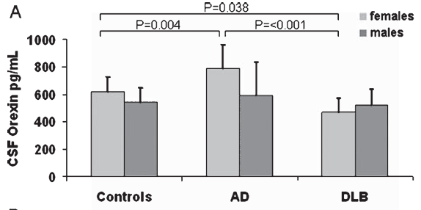
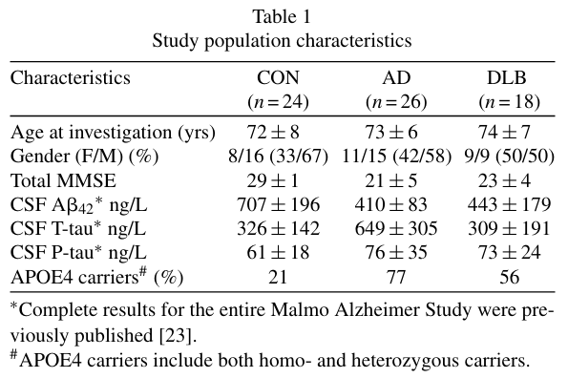
Orexin increases during AD (sex-specific).
Wennstrom et al., Journal of Alzheimer’s Disease (2012); patients still alive

Slide 23
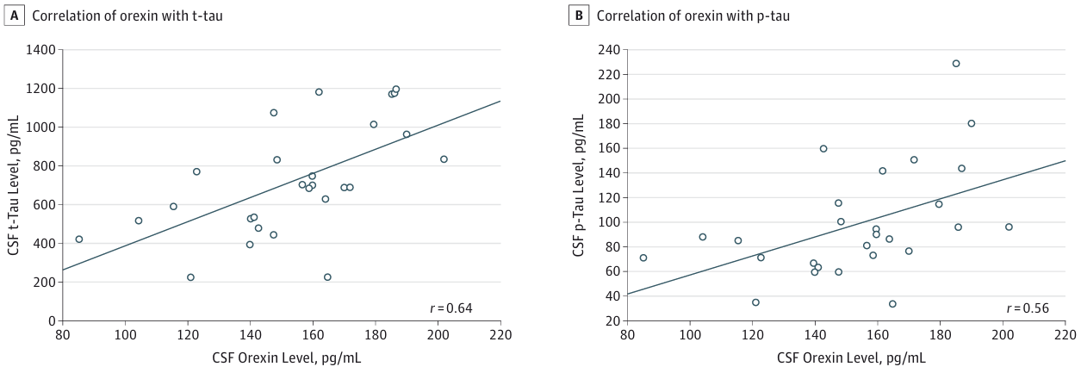
Positive correlation between CSF T-tau and P-tau levels and CSF Orexin levels.
Liguori et al., JAMA Neurology (2014); patients still alive

Slide 24
So, orexin is increasing during AD? And these increases are bad?

Slide 25
Conflicting results = unknown OX roles in AD
T-tau & P-tau
Aβ plaques
Protein Levels
Orexin?
Aβ42
Disease Progression
Notes:
How is orexin changing throughout the disease and what roles are these changes playing in disease progression and protein accumulation?

Slide 26
How does orexin administration and blockage impact memory in non-pathological settings?

Slide 27
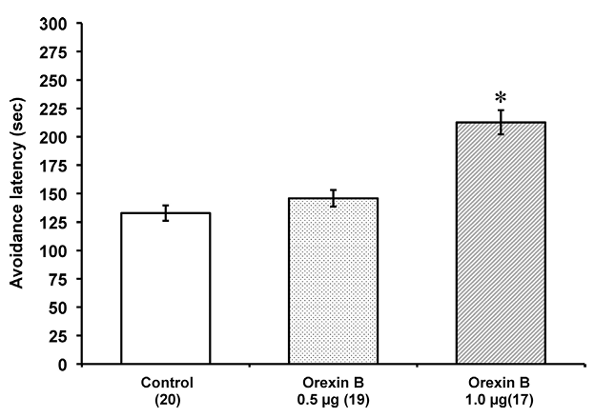
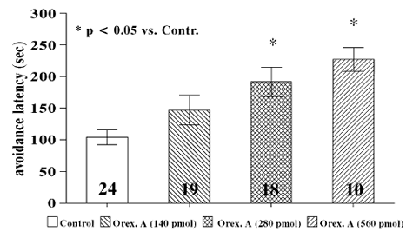
OXA and OXB administration improve learning and consolidation in passive avoidance task.
OXA OXB
Telegdy and Adamik, Regulatory Peptides (2002); Palotai et al., Behavioral Brain Research (2014)

Slide 28
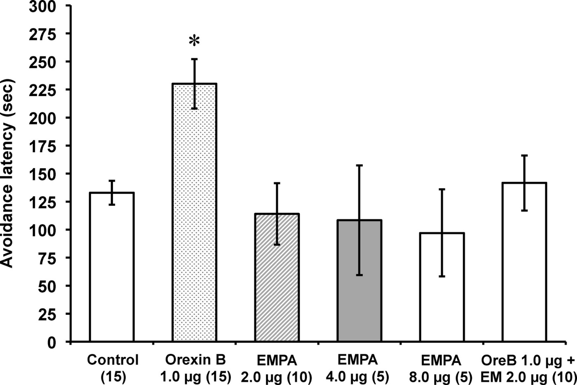
Blocking OX2R impaired memory consolidation on passive avoidance task.
Palotai et al., Behavioral Brain Research (2014)

Slide 29
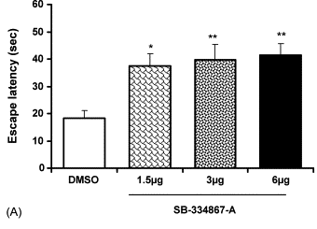
Blocking OX1R impairs memory acquisition and consolidation in Morris water maze.
Akbari et al., Peptides (2007)

Slide 30
OX administration and blocking in WT settings.
OXA administration
OXB administration
OX1R
OX2R
Improvements in learning and memory
Note: OXA administration promotes wakefulness

Slide 31
OX administration and blocking in WT settings.
OXA administration
OXB administration
SB-334867
OX1R
OX2R
Memory impairments
Note: Near normal sleep-wake patterns (OX1R KO mouse models)

Slide 32
OX administration and blocking in WT settings.
OXA administration
OXB administration
OX1R
OX2R
EMPA
Memory impairments
Note: Mild sleep phenotype, some sleep fractionation (OX2R KO mouse models)
Notes:
Almost seems like OXB signaling is more important for sleep phenotypes. Though, why does sleep phenotype become so much more pronounced when both are knocked out?

Slide 33
OX administration and blocking in WT settings.
OXA administration
OXB administration
OX1R
OX2R
Frequent cataplectic attacks; Fast transition from wake to REM sleep; Sleep fragmentation
(OXR double KO mouse models)
Note: cognitive phenotypes = unknown

Slide 34
How does orexin administration impact AD?

Slide 35
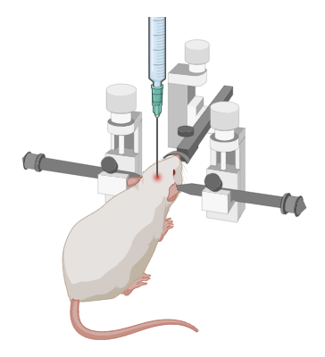
OXA ICV aggravates Aβ and sleep disturbances in Tg2576 mice.
Intracerebroventricular administration (ICV)
Kang et al., Science (2009)

Slide 36
OXA intranasal increased Aβ deposition in the brains of 3xTg-AD mice.
Li et al., Neurobiology of Aging (2023)
Notes:
14 days of intranasal administration before performing the tests and analyzing the mouse brains.

Slide 37
OXA intranasal increased p-Tau in the hippocampus of 3xTg-AD mice.
Li et al., Neurobiology of Aging (2023)

Slide 38
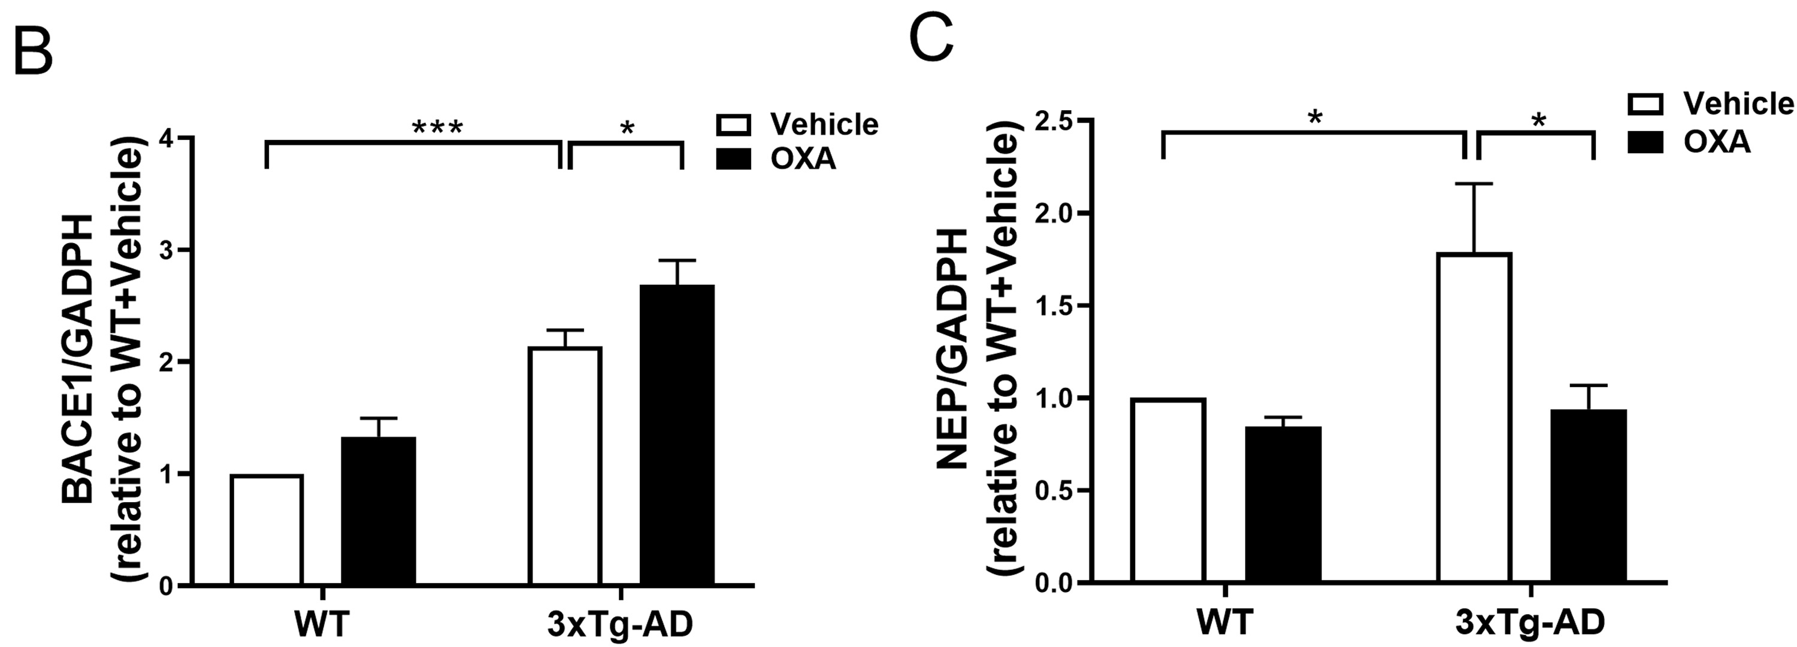
OXA intranasal impacted the expression of BACE1 and NEP in the hippocampus of 3xTg-AD mice.
BACE1 = Beta-secretase 1
NEP = Neprilysin
Li et al., Neurobiology of Aging (2023)
Notes:
NEP = membrane-bound metalloproteinase; soluble form of NEP is thought to degrade Aβ and be a potential mechanistic target for AD.
BACE1 = beta-secretase, which cleaves APP in the amylodigenic pathway to Aβ.

Slide 39
OXA intranasal damaged hippocampal LTP in 3xTg-AD mice.
Li et al., Neurobiology of Aging (2023)

Slide 40
OXA intranasal aggravates cognitive decline in 3xTg-AD mice
Li et al., Neurobiology of Aging (2023)

Slide 41
OXA intranasal aggravated the circadian locomotor disturbance in 3xTg-AD mice.
Li et al., Neurobiology of Aging (2023)

Slide 42
How does orexin blockage impact AD?

Slide 43
Suvorexant treatment rescued spatial learning and memory impairments in APP/PS1 mice.
Suvorexant (30 mg/kg) delivered orally once daily for 4 weeks
Zhou et al., Neurobiology of Aging (2020)
Notes:
Morris water maze task shown above.
Also performed Y-maze and found more correct arm entries after suvorexant treatment.

Slide 44
Almorexant treatment decreases Aβ.
Kang et al., Science (2009)

Slide 45
Almorexant treatment decreases Aβ.
Kang et al., Science (2009)

Slide 46
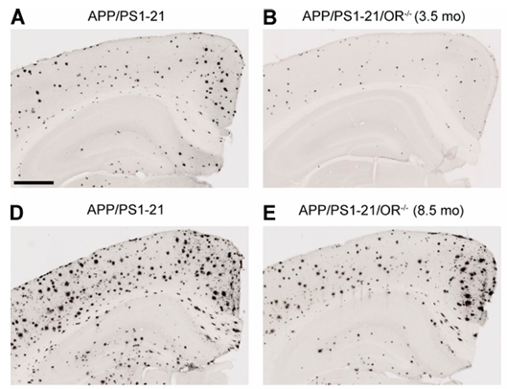
OXR knockout in AD mice decreased Aβ deposition in the brain.
Note: OXR knockout mice also showed decreased wakefulness in early phases of dark period (seen before onset of Aβ pathology).
Roh et al., The Journal of Experimental Medicine (2014)

Slide 47
What we know so far
WT mice
AD mice
OXA or OXB administration
Improvements in learning and memory

Slide 48
What we know so far
WT mice
AD mice
OXA or OXB administration
OXA administration
Improvements in learning and memory
Impairments in learning and memory

Slide 49
What we know so far
WT mice
AD mice
OXA or OXB administration
OX1R or OX2R blockage (individual)
OXA administration
Improvements in learning and memory
Impairments in learning and memory
Impairments in learning and memory

Slide 50
What we know so far
WT mice
AD mice
OXA or OXB administration
OX1R or OX2R blockage (individual)
OXA administration
OX1R and OX2R blockage (DORA)
Improvements in learning and memory
Impairments in learning and memory
Impairments in learning and memory
Improvements in learning and memory

Slide 51
What we know so far
WT mice
AD mice
OXA or OXB administration
OX1R or OX2R blockage (individual)
OXA administration
OX1R and OX2R blockage (DORA)
Improvements in learning and memory
Impairments in learning and memory
Impairments in learning and memory
Improvements in learning and memory

Slide 52
What we know so far
WT mice
AD mice
OXA or OXB administration
OX1R or OX2R blockage (individual)
OXA administration
OX1R and OX2R blockage (DORA)
Improvements in learning and memory
Impairments in learning and memory
Impairments in learning and memory
Improvements in learning and memory
What happens if we block OX1R or OX2R individually in AD?

Slide 53
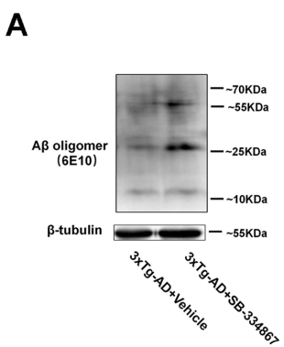
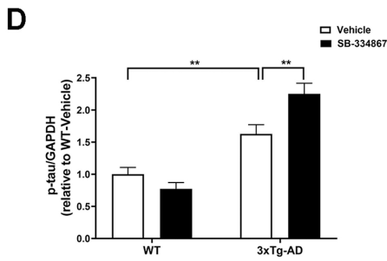
SB-334867 increased the expression of soluble Aβ oligomers and p-tau in the hippocampus of 3xTg-AD mice.
Gao et al., Behavioural Brain Research (2023)
Notes:
28 days of intraperitoneal injection before analyzing the mice or performing the behavioral tests.

Slide 54
SB-334867 decreased the expression of PSD-95 in the hippocampus of 3xTg-AD mice.
SYP: Synaptophysin (presynaptic marker)
PSD-95: Post synaptic density 95 (postsynaptic marker)
Gao et al., Behavioural Brain Research (2023)

Slide 55
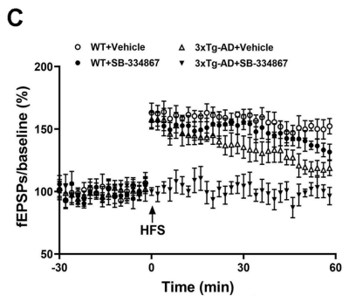
SB-334867 prevented long term potentiation in 3xTg-AD mice.
Gao et al., Behavioural Brain Research (2023)

Slide 56
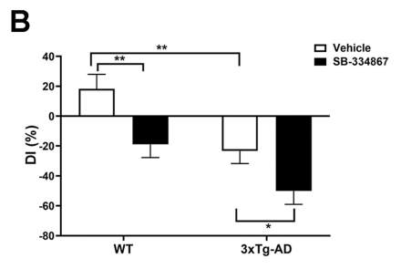
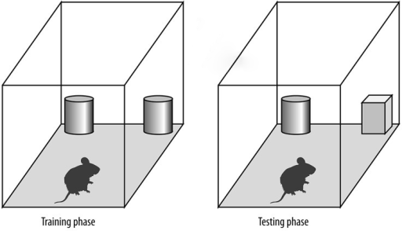
SB-334867 aggravated the impairment of short-term working memory in 3xTg-AD mice – Novel Object Recognition
Gao et al., Behavioural Brain Research (2023)
Notes:
RI = recognition index; the percentage of time exploring the novel object out of the total object exploration time
DI = discrimination index; how well they discriminated between novel and familiar object (lower DI = more time exploring familiar object)

Slide 57
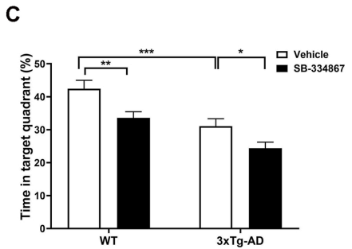
SB-334867 prevented 3xTg-AD mice from remembering the location of a hidden platform in the Morris Water Maze Test.
Gao et al., Behavioural Brain Research (2023)

Slide 58
What we know so far
WT mice
AD mice
OXA or OXB administration
OX1R or OX2R blockage (individual)
OXA administration
OX1R and OX2R blockage (DORA)
Improvements in learning and memory
Impairments in learning and memory
Impairments in learning and memory
Improvements in learning and memory

Slide 59
What we know so far
WT mice
AD mice
OXA or OXB administration
OX1R or OX2R blockage (individual)
OXA administration
OX1R and OX2R blockage (DORA)
OX1R blockage
Improvements in learning and memory
Impairments in learning and memory
Impairments in learning and memory; worsening Aβ phenotype
Improvements in learning and memory; decreases in Aβ phenotype
Impairments in learning and memory; worsening Aβ phenotype

Slide 60
Can we make sense of this information?
WT:
OXA or OXB administration → increased wakefulness → increased attention/memory → improvements in learning and memory

Slide 61
Can we make sense of this information?
WT:
OXA or OXB administration → increased wakefulness → increased attention/memory → improvements in learning and memory
OX1R or OX2R blockage → decreased wakefulness → decreased attention/memory processes → impairments in learning and memory

Slide 62
Can we make sense of this information?
WT:
OXA or OXB administration → increased wakefulness → increased attention/memory → improvements in learning and memory
OX1R or OX2R blockage → decreased wakefulness → decreased attention/memory processes → impairments in learning and memory
AD:
OXA administration → increased wakefulness (less sleep) → an already stressed system now seeing more stress → impairments in learning and memory and worsening Aβ phenotype

Slide 63
Can we make sense of this information?
WT:
OXA or OXB administration → increased wakefulness → increased attention/memory → improvements in learning and memory
OX1R or OX2R blockage → decreased wakefulness → decreased attention/memory processes → impairments in learning and memory
AD:
OXA administration → increased wakefulness (less sleep) → an already stressed system now seeing more stress → impairments in learning and memory and worsening Aβ phenotype
OX1R and OX2R blockage → decreased wakefulness (more sleep) → less stress on an already stressed system → improvements in learning and memory and decreases in Aβ phenotype

Slide 64
Can we make sense of this information?
WT:
OXA or OXB administration → increased wakefulness → increased attention/memory → improvements in learning and memory
OX1R or OX2R blockage → no impact on sleep or decreased wakefulness → decreased attention/memory processes → impairments in learning and memory
AD:
OXA administration → increased wakefulness (less sleep) → an already stressed system now seeing more stress → impairments in learning and memory and worsening Aβ phenotype
OX1R and OX2R blockage → decreased wakefulness (more sleep) → less stress on an already stressed system → improvements in learning and memory and decreases in Aβ phenotype
OX1R blockage → no impact on sleep (due to OX1R KO mice phenotype) → no differences in sleep quality/quantity → no changes in stress on system → impairments in learning and memory and worsening Aβ phenotype

Slide 65
Can we make sense of this information?
WT:
OXA or OXB administration → increased wakefulness → increased attention/memory → improvements in learning and memory
OX1R or OX2R blockage → no impact on sleep or decreased wakefulness → decreased attention/memory processes → impairments in learning and memory
AD:
OXA administration → increased wakefulness (less sleep) → an already stressed system now seeing more stress → impairments in learning and memory and worsening Aβ phenotype
OX1R and OX2R blockage → decreased wakefulness (more sleep) → less stress on an already stressed system → improvements in learning and memory and decreases in Aβ phenotype
OX1R blockage → no impact on sleep (due to OX1R KO mice phenotype) → no differences in sleep quality/quantity → no changes in stress on system → impairments in learning and memory and worsening Aβ phenotype
Need to test OXB administration and OX2R blockage in AD mice.

Slide 66
Conclusions

Slide 67
Conclusions
OX changes during aging and AD… how is still unknown??

Slide 68
Conclusions
OX changes during aging and AD… how is still unknown??
OX impacts WT vs AD settings differently

Slide 69
Conclusions
OX changes during aging and AD… how is still unknown??
OX impacts WT vs AD settings differently
Differences in dosing between groups could account for differences
WT mice: OXA or OXB administered 3x before testing; OXR blockage is acute
AD mice: OXA administered 2-3 weeks before testing; OXR blockage is chronic

Slide 70
Conclusions
OX changes during aging and AD… how is still unknown??
OX impacts WT vs AD settings differently
Differences in dosing between groups could account for differences
WT mice: OXA or OXB administered 3x before testing; OXR blockage is acute
AD mice: OXA administered 2-3 weeks before testing; OXR blockage is chronic
Notes:
Acute vs chronic could be a big deal here, because even in some of the AD models where they used WT mice as controls, were seeing some negative effects, similar to what we see in AD in the WT mice. This is just usually not as pronounced as what we see in the AD mice, though it is still present.

Slide 71
Take Home Message
Sleep
AD
Orexin

